Slide 1
Chapter7 (Lecture1) Structuring System Requirements: Conceptual Data Modeling

Slide 2
Lecture’s Agendas:
Entity- Relationship Model VS Entity- Relationship Diagram.
The purpose of using ER-Diagram.
Main components of ER-Diagram: Entity, Attribute, Relationship, and Cardinality.

Slide 3
Entity-Relationship Model VS Entity-Relationship Diagram.
Entity- Relationship Model:
It is a detailed, logical representation of the entities, associations and data elements for an organization or business area.
Entity-Relationship Diagram.
It is a graphical representation of an E-R model.
It is a model that identifies the concepts or entities that exist in a system and the relationships between those entities

Slide 4
The Purpose of Using ER-Diagram.
1. We determine the requirements of an information system by drawing a conceptual ERD that represents the high-level business objects/entities of the system.
2.The database analyst/designer gains a better understanding of the information to be contained in the database through the process of constructing the ERD. (Prepare the system for the next phase of SDLS which is System Design.)

Slide 5
Main Components of ER-Diagram
There are four main components of Entity-Relationship Diagram:
Entity.
Attribute.
Relationship.
Cardinality.

Slide 6
First: Entity
It is a Real-world object distinguishable from other objects.
It can be an object with a physical existence (person, house) or an object with conceptual existence (company, job, university, course).
It should be a singular noun.

Slide 7
Entity (Cont.)
Any entity can be classified in one of the following categories:
Regular Entity: any physical object, event, or abstract concept that we can record facts about. (It has a primary key.)
Weak Entity: any entity that depends on another entity for its existence. A weak entity is the entity which can't be fully identified by its own attributes and takes the foreign key as an attribute (generally it takes the primary key of the entity it is related to and it is called a foreign key).
Entity
Weak Entity

Slide 8
Second: Attribute
Each Entity has a set of Attributes
Attribute is a property or characteristic of an entity that is of interest to the organization.
Example: STUDENT: Student_ID, Student_Name, Phone_Number, Major.
An attribute name:
Should be a noun and capitalize the first letter of each word. (Example: Student_Name.)
Should be unique.
Attribute names are enclosed by ovals and connected to their entities by single line.
Attribute
Attribute
Entity

Slide 9
Attribute (Cont.)
Some types of attributes:
Single Value Attribute: Attributes having single value for particular entity. Ex: Age
Multivalued Attribute: It can have more than one value at a time for an attribute. For ex., the skills of a surgeon is a multivalued attribute since a surgeon can have more than one skill. Another common example is the address field, which can have multiple values like zipcode, street address, state, etc.
Key Attribute: the attribute which uniquely identifies each entity is called key attribute. (Primary Key and Foreign Key.) It has to be underlined. Ex: Student_ID
Derived Attribute: It is an attribute whose value is calculated (derived) from other attributes. The derived attribute need not be physically stored within the database; instead, it can be derived by using an algorithm. Age can be derived from DoB.
Composite attribute: It is an attribute where the values of that attribute can be further subdivided into meaningful sub-parts." Typical examples for composite attribute are; Name – may be stored as first name, last name, middle initial

Slide 10
Attribute (Cont.)
Single Value Attribute
Derived Attribute
Multivalued Attribute
Composite Attribute
Key Attribute

Slide 11
Third: Relationship
A relationship is an association between two or several entities that is of particular interest.
It represents interactions between two or more entities.
A relationship name should Be a verb phrase, such as Is_assigned_to.
Relation

Slide 12
Relationship (Cont.)
Example: Relationship ‘WORKS-FOR’ between the entities of EMPLOYEE and DEPARTMENT associates each employee with the department for he works.
Employee
WORKS-FOR
Department

Slide 13
Relationship (Cont.)
The Degree of a Relationship
It is the number of entity types that participate in a relationship.
There are 3 common relationships:
Unary or Recursive relationship (degree one): a relationship between a one entity to itself.
Binary (degree two): a relationship between two entities.
Ternary (degree three): a relationship between three entities.

Slide 14
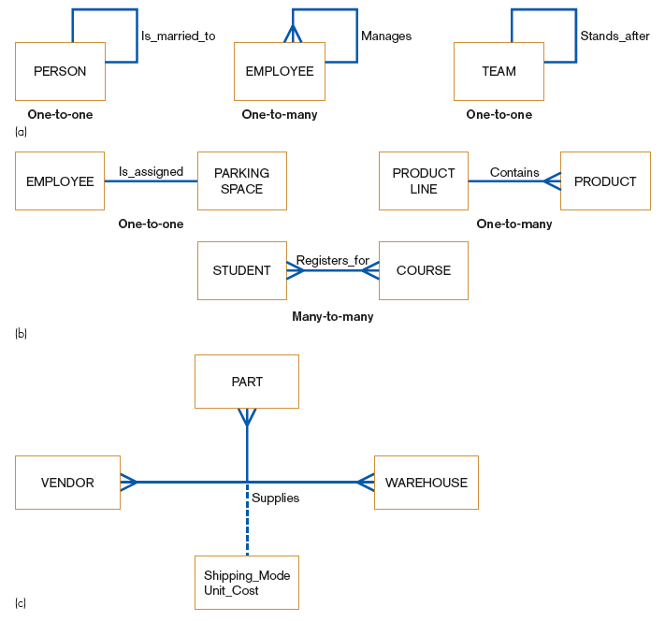
Relationship (Cont.)
Unary relationships
Examples of relationships of different degrees:
Binary relationships
Ternary relationships

Slide 15
Fourth: Cardinality Types of Cardinalities:
One-to-one (1:1)
1
1
Man
Woman
One-to-many (1:n)
1
M
Order
Customer
Many-to-many (n:m)
M
M
Course
Subject
Cardinality: is the number of instances of entity A that can (or must) be associated with each instance of entity B
Notes:
12
12

Slide 16
Cardinality (Cont.)
Cardinality:
The number of instances of entity B that can (or must) be associated with each instance of entity A.
Minimum Cardinality:
The minimum number of instances of entity B that may be associated with each instance of entity A
Maximum Cardinality:
The maximum number of instances of entity B that may be associated with each instance of entity A
Notes:
12
12

Slide 17
Cardinality (Cont.)
The Classification of Cardinalities
Optional Cardinality:
An Employee may or may not be assigned to a Department.
A Patient may or may not be assigned to a Bed.
Mandatory Cardinality:
Every Course must be taught by at least one Teacher.
Every mother has at least a Child.

Slide 18
Cardinality (Cont.) The Crow’s Foot Notation for ER Diagram
Mandatory 1 and only 1 cardinality
Mandatory one or many cardinality
Optional 0 or 1 cardinality
Optional zero-many cardinality

Slide 19
Cardinality (Cont.) The Crow’s Foot Notation for ER Diagram
Employee
Manage
Department
Employee
Work_for
Department

Slide 20
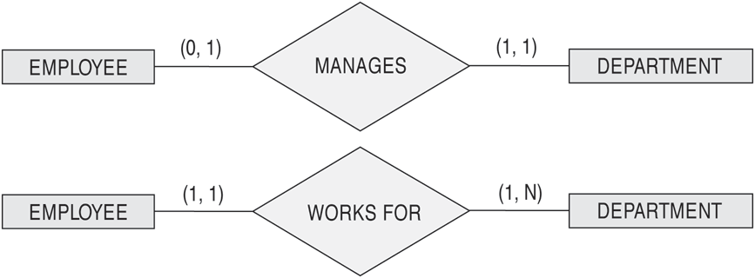
Cardinality (Cont.) The (min,max) Notation for relationship constraints

Slide 21
Thank You
Notes:
5
5

